Slide 1
De SwissPollen au modèle de dispersion et prévision pollinique en Suisse
Bernard Clot

Slide 2
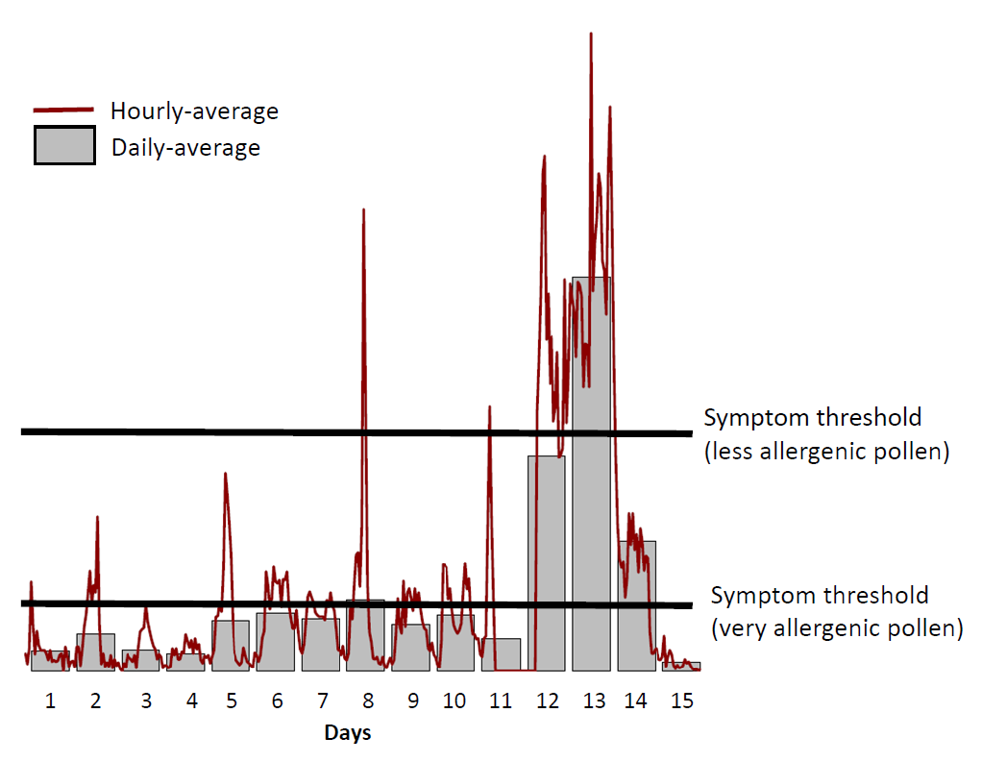
Benefits of automatic pollen monitoring
Timely information “real-time”
Early warning, preventive medication, operative decision making
Input for forecasts and models
High temporal resolution
Quality improvement
Better understanding of aerobiological phenomena and drivers of allergy
Convergence with aerosol and air quality measurements

Slide 3
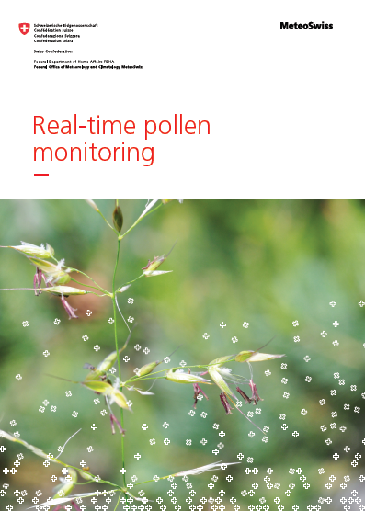
Project Swiss automatic pollen monitoring network
2017 Study “Socio-economic benefits of real-time pollen data”
2018-19 Initialization, concept and public tender
2020 Proof-of-concept and begin instruments rollout
2021 First real-time data available online
2022 Deployment completed
2023-24 New products / dissemination channels
Development of the data infrastructure
Full integration into MeteoSwiss surface networks
Development of QA/QC with METAS
Optimization of the network representativity (sites)
Adaptation of the forecasting models
Development of new products / dissemination channels

Slide 4
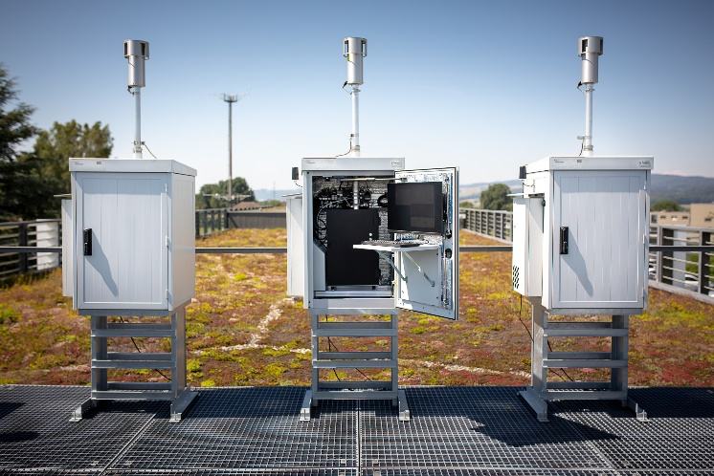
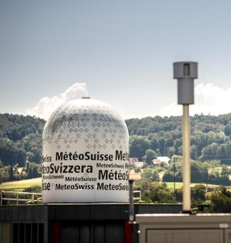
Swisens Poleno

Slide 5
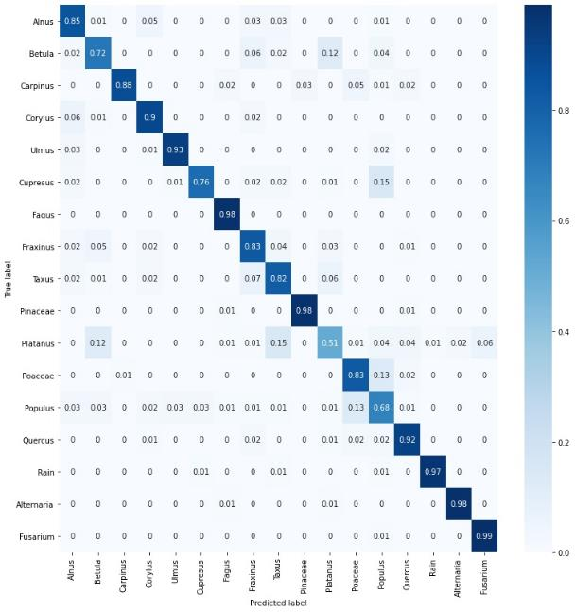
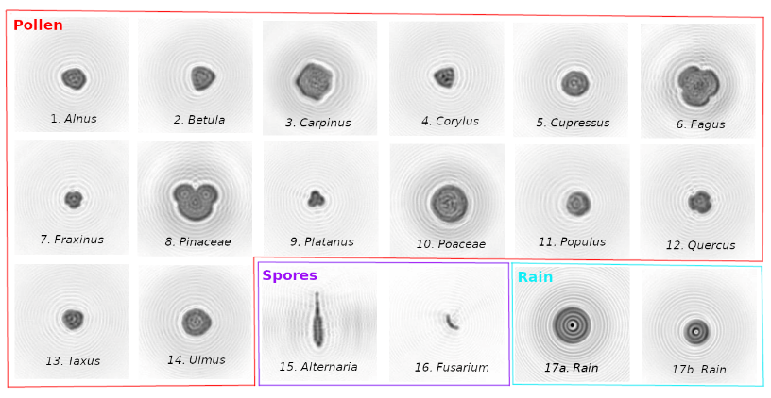
Bioaerosol classification using deep learning
Normalized confusion matrix summarizing the performance

Slide 6
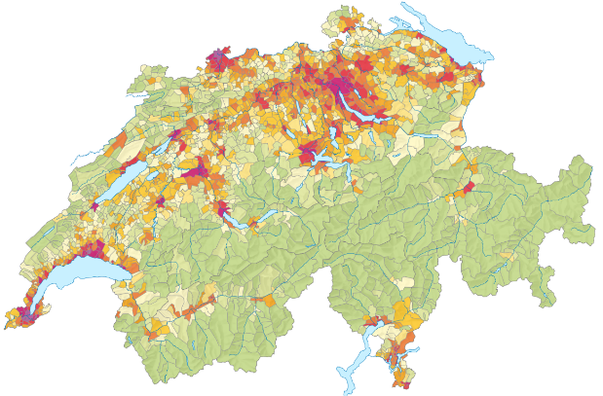
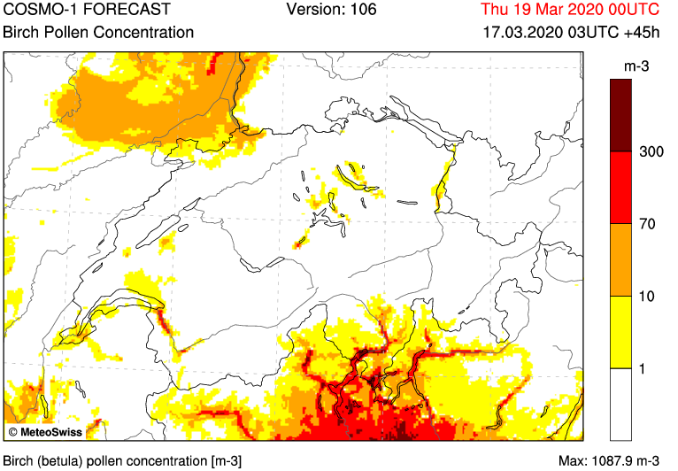
Optimization of the network representativity: 14 →18+ sites
COSMO dispersion model

Slide 7
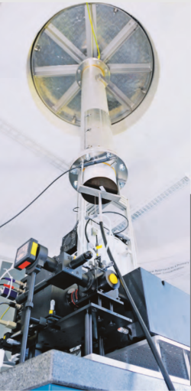
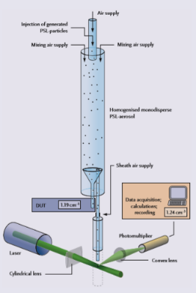
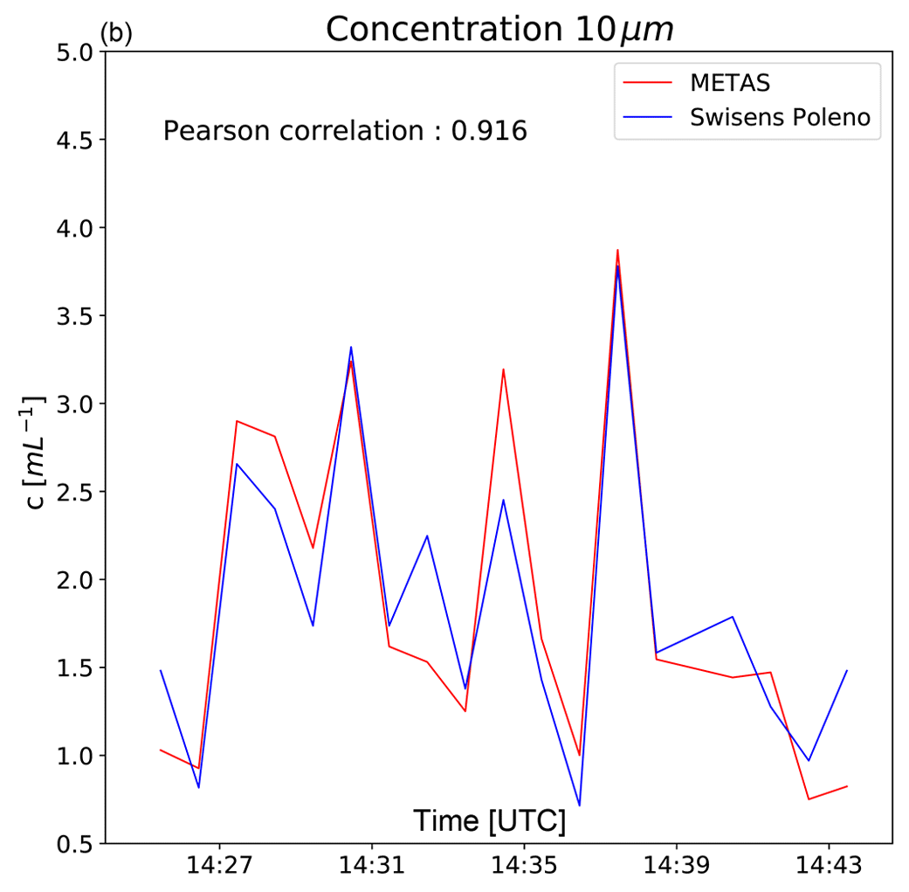
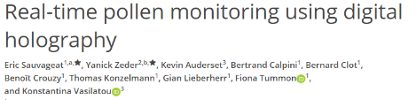
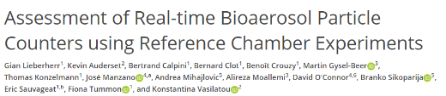
Validation and calibration @ Federal Institute of Metrology METAS
Validation using
certified OPCs
2020
2021

Slide 8
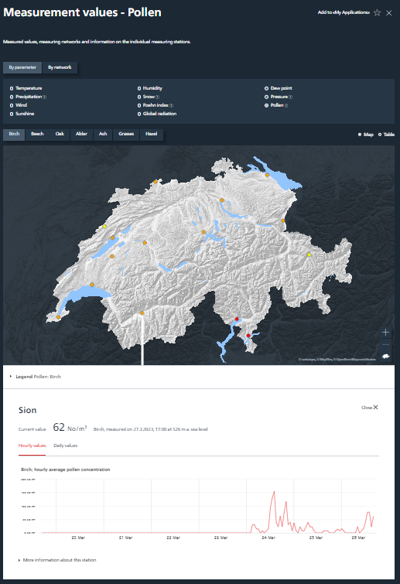
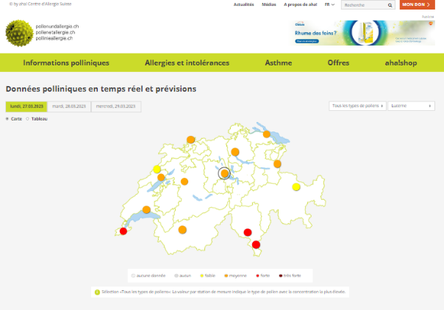
Pollen information on meteoswiss.ch and pollenetallergie.ch

Slide 9
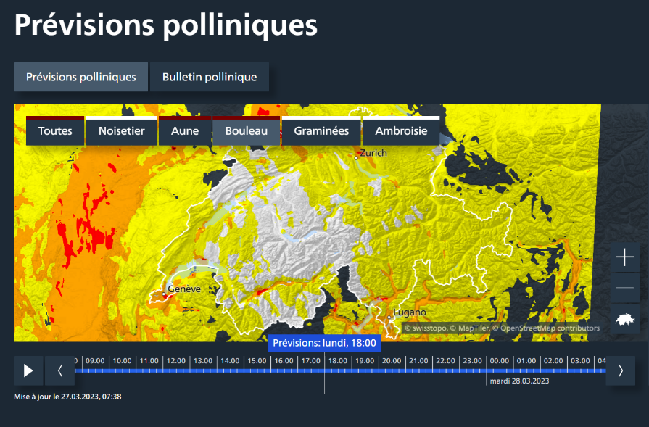
Adaptation of the forecasting model COSMO
www.meteoswiss.ch
MeteoSwiss App
From January 2022 every model run integrates real-time data

Slide 10
The COSMO-ART pollen module
Pollen season
Emission
Dispersion
Start of
flowering
Height correction
of the emisson
actual
weather
Pollen sedimentation
and wash out
by precipitation
Temperature
sum
Length of the
pollen season
State of the
season
Pollen
emission
Tuning
Factor
Pollen
concentration
End of
flowering
Mathematical
function
Distribution of the
allergenic plant
Transport
budget
  Real-time calibration:
  Phenology: Adapting start and end of flowering (variable T sum threshold fields)
  Intensity: Adapting the strength of pollen emission (new tuning field)
Notes:
COSMO seeks to integrate all processes that lead to the pollen concentration. Very similar to what the forcaster does (Where are the plants? Do they flower? Are the met. conditions favourable for emission? Where are the pollen transported?)
Pollen season model: more detail in the part «Use of real-time pollen data»

Slide 11
Use of real-time pollen data (1): Phenology
Sum of Daily Temperature at 14 UTC
Adjusted with Real-Time Data
Critical Thresholds for Temperature Sum
Season End
Day of the Year
Season Start
Work & Slide: Simon Adamov
Notes:
Conceptual view:
The temperature sum model is a widely applied method to model pollen It has been in use at MCH for a few years now The complex bio-chemical properties of the plant are parametrised by a simple and exactly measured meteorological variable
The start and end of the season are set by thresholds and between those no trees -> all trees -> no trees are blooming

Slide 12
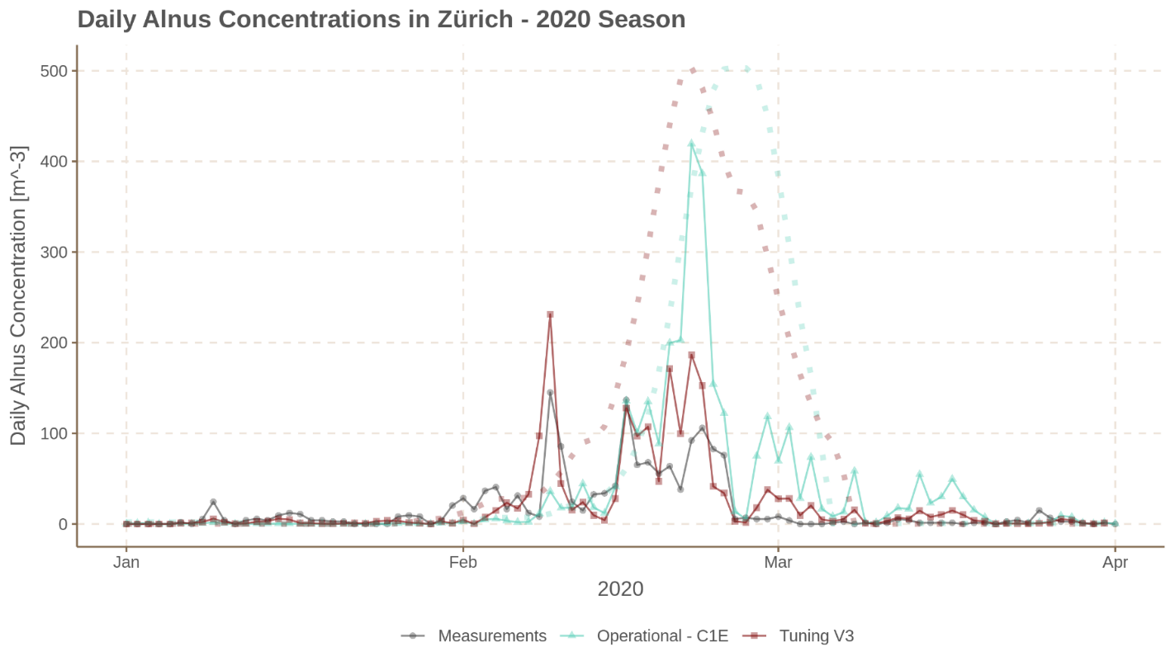
Work & Slide: Simon Adamov
Notes:
Effect of tthrs calibration

Slide 13
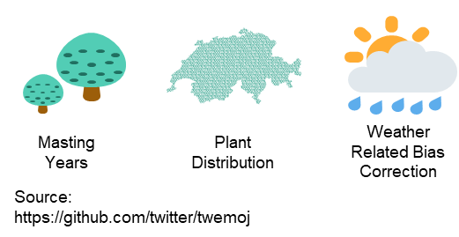
Use of real-time pollen data (2): Tuning
Use concentration difference Model – Observation somehow…
=> 14-18 stations in Switzerland (+ AutoPollen network!)
Attribution…? => Bias correction
Chosen technical option (after many tests):
apply every hour in the KENDA cycle
(obs/mod _{past 120h})^1/24 to the tuning factor at each station + interpolate onto grid
Notes:
Routine update_strength_realtime is called every hour in the KENDA cycle (updated Tune-field is passed on to the forecast run)
^24 so that it takes 24 hours for a «full» correction
Documentation on https://service.meteoswiss.ch/confluence/pages/viewpage.action?pageId=85492853

Slide 14
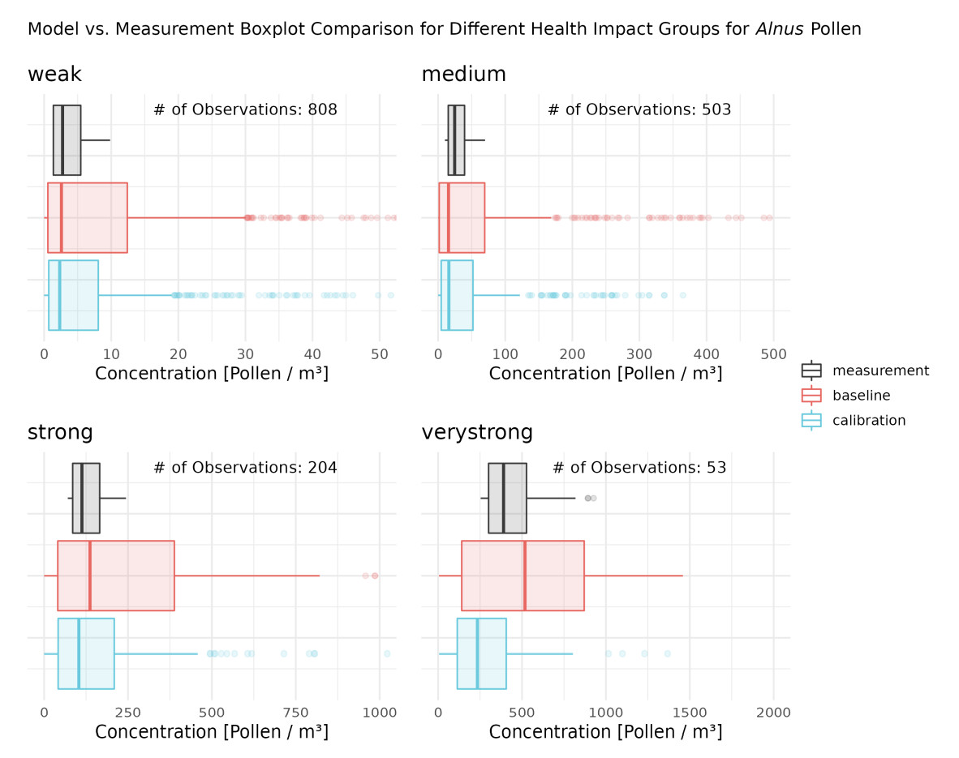
Adamov & Pauling,
Aerobiologia, submitted
Notes:
Overall comparison per concentration class ALNUS

Slide 15
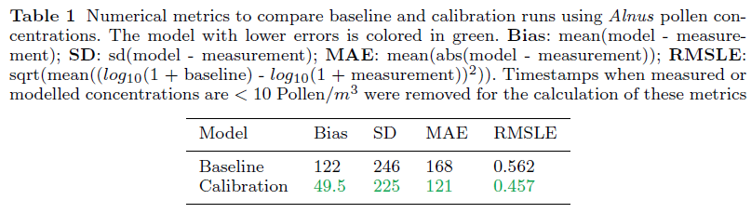
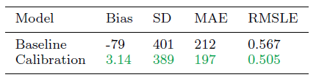
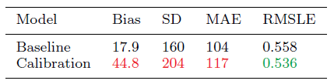
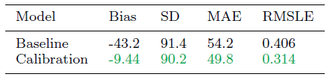
Results
Alder
Birch
Hazel
Adamov & Pauling,
Aerobiologia, submitted
Grasses
Notes:
Based on 2019-21 parallel runs
Substantial reduction of BIAS above all
CORY: new species already well tuned at least for 2020 and 2021 (Bias only 17.9), further investigation needed. The 2022 opr seasson showed that Haazel was well modelled (but no parallell run availabel in 2022!)

Slide 16
Take home messages
The whole information chain needs to be updated (from measurement to distrivbution channels)
Real-time pollen data used in COSMO-ART => substantial improvements for Alder, Birch and Poaceae, not with hazel (yet)
Was used operationally already in 2022 by MeteoSwiss
COSMO-ART → ICON-ART
Model domain Alps run by MeteoSwiss (COSMO → ICON)
Model domain Europe run by DWD (ICON)
https://www.dwd.de/DE/leistungen/pollen/pollenforschung.html

Slide 17
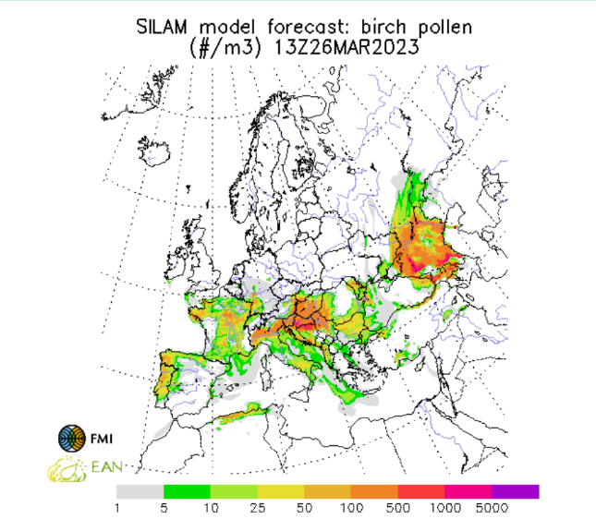
Other pollen dispersion module available in Europe
https://silam.fmi.fi/
used e.g. by Copernicus CAMS
https://atmosphere.copernicus.eu

Slide 18
Our publications on automatic pollen monitoring
Kawashima S, et al. 2007. An algorithm and a device for counting airborne pollen automatically using laser optics. https://doi.org/10.1016/j.atmosenv.2007.09.019
Crouzy B, et al. 2016. All-optical automatic pollen identification: towards an operational system. https://doi.org/10.1016/j.atmosenv.2016.05.062
Kawashima S, et al. 2017. Automated pollen monitoring system using laser optics for observing seasonal changes … https://doi.org/10.1007/s10453-017-9474-6
Fernández-Rodríguez S, et al. 2018. Comparison of fungal spores concentrations measured with wideband integrated … https://doi.org/10.1016/j.atmosenv.2017.11.038
Šaulienė I, et al. 2019. Automatic pollen recognition with the Rapid-E particle counter: the first-level procedure… https://doi.org/10.5194/amt-12-3435-2019
Oteros J, et al. 2019. Building an automatic pollen monitoring network (ePIN): Selection of optimal sites by clustering … https://doi.org/10.1016/j.scitotenv.2019.06.131
Huffman JA, et al. 2019. Real-time sensing of bioaerosols: Review and current perspectives. https://doi.org/10.1080/02786826.2019.1664724
Chappuis C, et al. 2019. Automatic pollen monitoring: first insights from real-time data. https://doi.org/10.1007/s10453-019-09619-6
Sauvageat E, et al. 2020. Real-time pollen monitoring using digital holography. https://doi.org/10.5194/amt-13-1539-2020
Clot B, et al. 2020. The EUMETNET AutoPollen Programme: establishing a prototype automatic pollen monitoring network ... https://doi.org/10.1007/s10453-020-09666-4
Tummon F, et al. 2021. The need for Pan-European automatic pollen and fungal spore monitoring: a Stakeholder Workshop Position Paper. http://doi.org/10.1002/clt2.12015
Adamov S, et al. 2021. On the measurement uncertainty of Hirst-type volumetric pollen and spore samplers. https://doi.org/10.1007/s10453-021-09724-5
Tummon F, et al. 2021.A first evaluation of multiple automatic pollen monitors run in parallel. https://doi.org/10.1007/s10453-021-09729-0
Lieberherr G, et al. 2021. Assessment of real-time bioaerosol particle counters using reference chamber experiments. https://doi.org/10.5194/amt-14-7693-2021
Buters J, et al. 2022. Automatic Detection of airborne Pollen: An Overview. https://doi.org/10.1007/s10453-022-09750-x
Crouzy B, et al. 2022. False Positives: Handling them operationally for automatic pollen monitoring. https://doi.org/10.1007/s10453-022-09765-4
Tummon F, et al. 2022. Towards standardisation of automatic pollen and fungal spore monitoring: Best practises and guidelines. https://doi.org/10.1007/s10453-022-09755-6
Maya-Manzano J., et al. 2022. Towards European automatic bioaerosol monitoring: Comparison of 9 automatic pollen … https://doi.org/10.1016/j.scitotenv.2022.161220
Erb S, et al. 2023. Automatic real-time monitoring of fungal spores: the case of Alternaria spp. https://doi.org/10.1007/s10453-023-09780-z
Beggs PJ, et al. 2023. Climate change, airborne allergens, and three translational mitigation approaches. https://doi.org/10.1016/j.ebiom.2023.104478

Slide 19
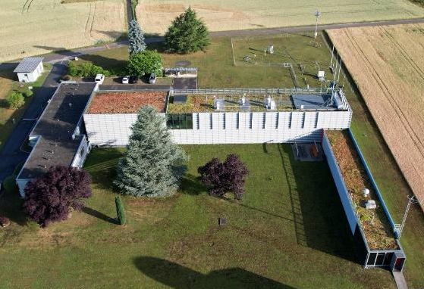





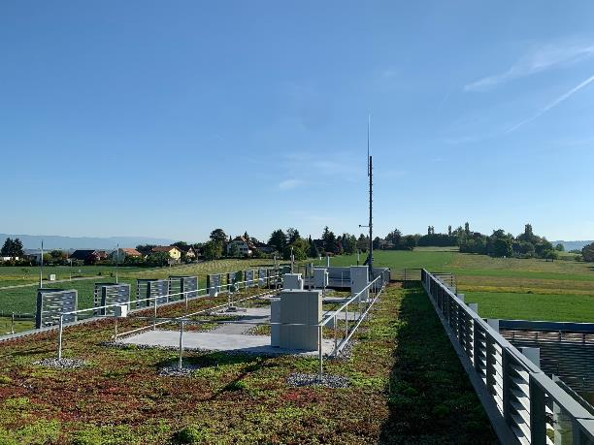








The Pollen Team @MeteoSwiss
The Payerne pollen station
B. Clot
B. Crouzy
F. Tummon
G. Lieberherr
S. Erb
R. Gehrig
A. Pauling
S. Adamov
C. Sallin
M.J. Graber
F. Vuillemin
A.M. Rachoud
R. Bersier

