Slide 1

EUMETNET
AutoPollen Programme

Slide 2
EUMETNET
A grouping of 31 European National Meteorological Services
EUMETNET AutoPollen Programme (Coordination MeteoSwiss)
Aims to provide the basis for the establishment of an automatic pollen monitoring network considering the whole information chain - from the initial observation through to the final products communicated to the public – and to pave the way for the extension of this activity.
https://www.eumetnet.eu/activities/miscellaneous/current-activities-mi/autopollen/
https://autopollen.net/ (in development)

Slide 3
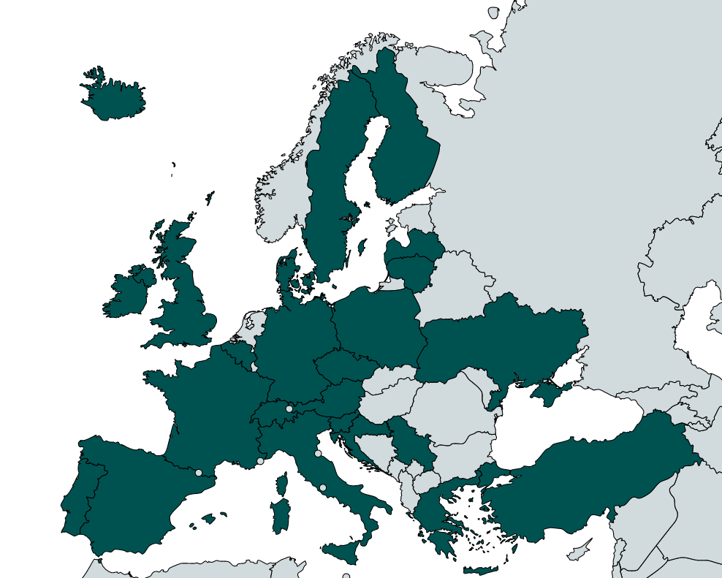
AutoPollen Participants
The AutoPollen Programme currently involves 12 EUMETNET members as well as 14 third party organisations (other institutes responsible for pollen monitoring, e.g. Environmental Agencies) and 2 European-level organisations (patient (EFA) and aerobiology (ESA) networks). It collaborates with Copernicus CAMS.

Slide 4
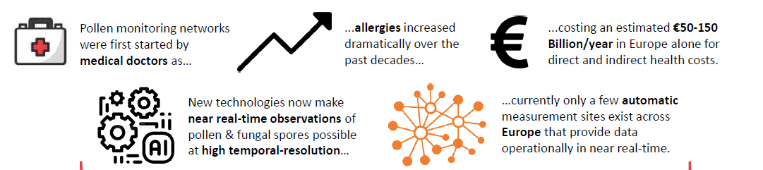
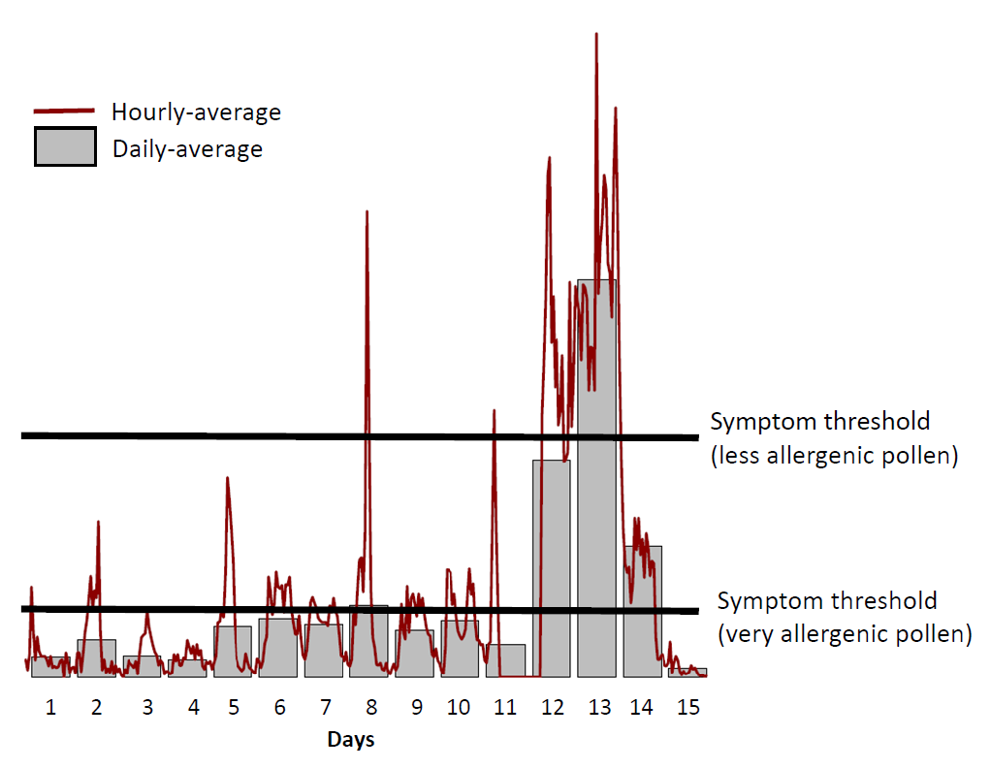
The raison d’être for pollen monitoring…
…and a paradigm change
Pollen monitoring networks were first started by medical doctors as…
High temporal-resolution real-time measurements
…allergies increased dramatically over the past decades, affecting more than 100 million Europeans…
…costing an estimated €50-150 Billion/year in Europe alone for direct and indirect health costs.

Slide 5






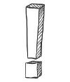



End-to-End Information System
The AutoPollen Programme covers all aspects of the information chain: from the initial measurements through to the communication of targeted information to end-users
Instruments
and sites
Data
QA/QC
Forecasts
Products
Impacts
Stakeholder Interaction
Communication + Collaboration
More on this topic: programme decision

Slide 6
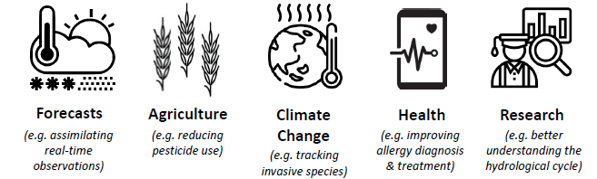
Beyond just allergies
Real-time pollen and fungal spore data can be used for a wide range of applications, for example:
Tummon et al., 2021
Leading to:
        New partnerships and collaborations
        Innovative products and services
        Impact-based forecasts and warnings
More on this topic: Tummon et al 2021

Slide 7
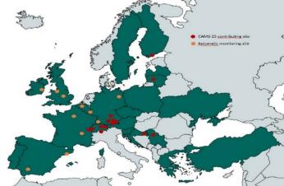
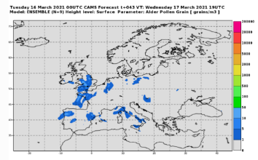


AutoPollen: Key Results
Growing number of automatic monitoring sites across Europe
Prototype Network functioning – supported by CAMS-23 Project
Collaboration with CEN to develop a Technical Specification
Collaboration with H-2020 AEROMET-II project on data quality

Slide 8
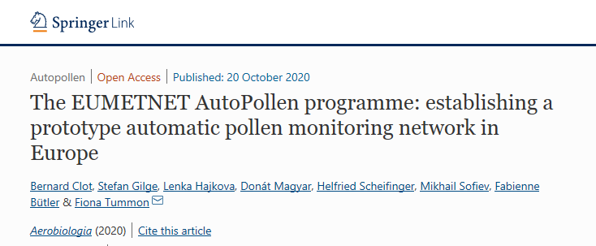

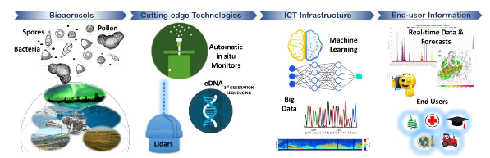
AutoPollen: Key Results
Special Issue in Aerobiologia to publish results and recommendations
Stakeholder Workshop (2020) and subsequent publication
Tummon F, Arboledas LA, Bonini M, Guinot B, Hicke M, Jacob C, Kendrovski V, McCairns W, Petermann E, Peuch VH, Pfaar O, Sicard M, Sikoparija B, Clot B. 2021. The need for Pan-European automatic pollen and fungal spore monitoring: A Stakeholder Workshop Position Paper. Clin. Transl. Allergy, in press.
Horizon Europe SYLVA Project
2023-2026
AutoPollen-ADOPT Intercomparison Campaign 2021

Slide 9
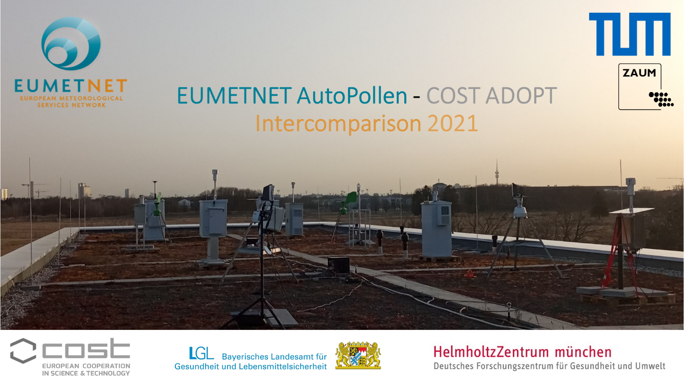

Slide 10

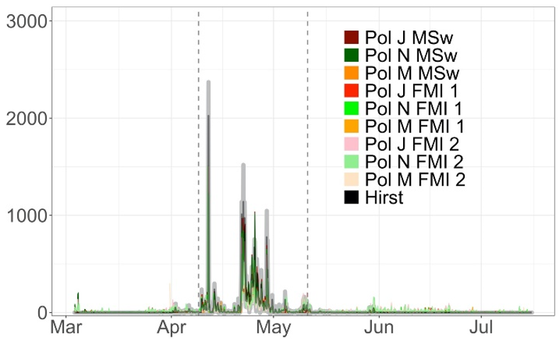
Instrument intercomparison 2021
Overall, several instruments perform as well as manual methods but in addition provide data in real-time and at higher temporal resolution (up to hourly or less)
Two steps need to be considered:
1. instrument
2. identification algorithm
See the results for yourself at:
https://autopollen-interactive.shinyapps.io/022_APP_AUTOPOLLEN

Slide 11
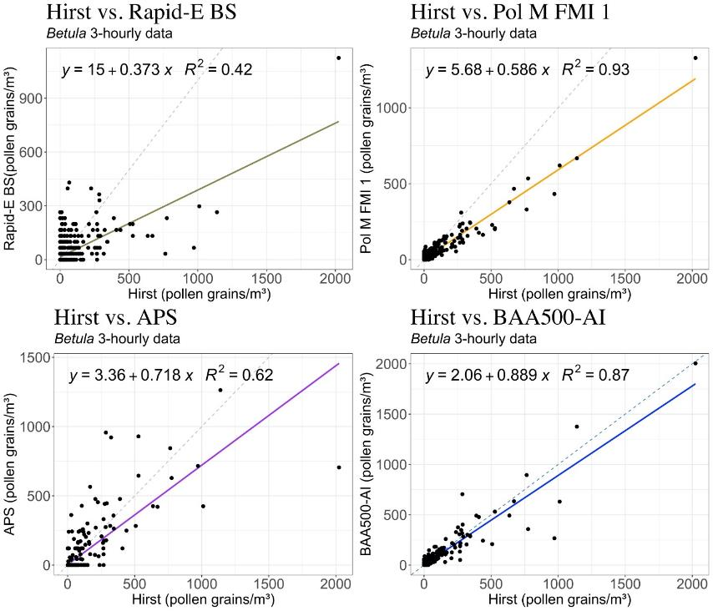
Scatter plot: 3-hourly data

Slide 12
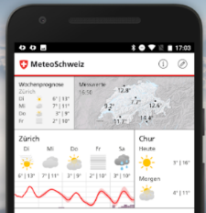
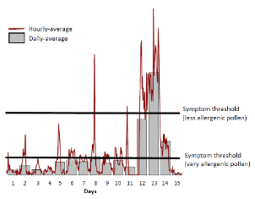
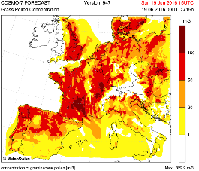
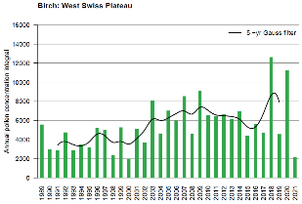
Conclusion
Automation of pollen measurements improves the whole information chain, up to products for end-users, and opens the door to a new era in aerobiology going beyond just pollen
Collaboration is key → EUMETNET AutoPollen
  national, international, interdisciplinary...
New research insights (hourly resolution, spores,..)
Real time data in the app and web
Guarantee long term data series
Improved forecasts

Slide 13
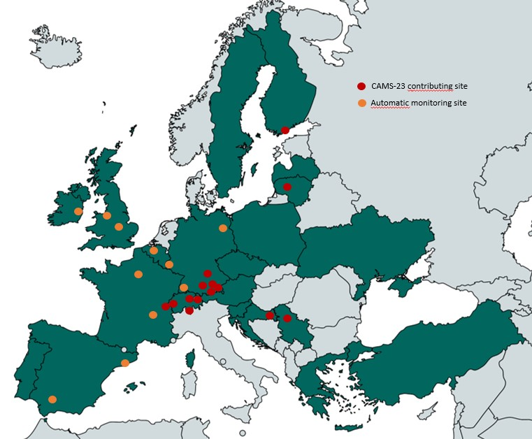
An expanding network
Bavaria, Germany: https://epin.lgl.bayern.de/pollenflug-aktuell
Finland: https://en.ilmatieteenlaitos.fi/atmospheric-bioaerosols-modelling
Lithuania:
https://miestoplauciai.vilnius.lt/ziedadulkes/
Manchester, UK: www.urbanobservatory.manchester.ac.uk/uk-first-realtime-pollen-count-now-live
Serbia and Croatia: www.realforall.com/language/en/measurements/
Switzerland: https://www.meteoswiss.admin.ch/services-and-publications/applications/measurement-values-and-measuring-networks.html#param=messwerte-pollen-birke-1h&lang=en

Slide 14
EUMETNET AutoPollen publications
Clot B, et al. 2020. The EUMETNET AutoPollen Programme: establishing a prototype automatic pollen monitoring network ... https://doi.org/10.1007/s10453-020-09666-4
Tummon F, et al. 2021. The need for Pan-European automatic pollen and fungal spore monitoring: a Stakeholder Workshop Position Paper. http://doi.org/10.1002/clt2.12015
Buters J, et al. 2022. Automatic Detection of airborne Pollen: An Overview. https://doi.org/10.1007/s10453-022-09750-x
Tummon F, et al. 2022. Towards standardisation of automatic pollen and fungal spore monitoring: Best practises and guidelines. https://doi.org/10.1007/s10453-022-09755-6
Maya-Manzano J., et al. 2022. Towards European automatic bioaerosol monitoring: Comparison of 9 automatic pollen … https://doi.org/10.1016/j.scitotenv.2022.161220

Slide 15
Contact Details
Bernard Clot, AutoPollen Programme Manager
Fiona Tummon, AutoPollen Scientific Coordinator
AutoPollen Programme Manager
MeteoSwiss
Chemin de l’Aérologie
CH - 1530 Payerne
Tel: +41 58 460 93 98
Email: bernard.clot@meteoswiss.ch
Web: www.meteoswiss.ch
GIE EUMETNET Secretariat
c/o L’Institut Royal Météorologique
Avenue Circulaire 3
BE - 1180 Bruxelles
Tel: +32 (0)2 373 05 18
Email: info@eumetnet.eu
Web: www.eumetnet.eu

